Slide 1
Introduction to yoga and meditation for professional excellence and stress Management
Vivek Garg
CSVTU Bhilai

Slide 2
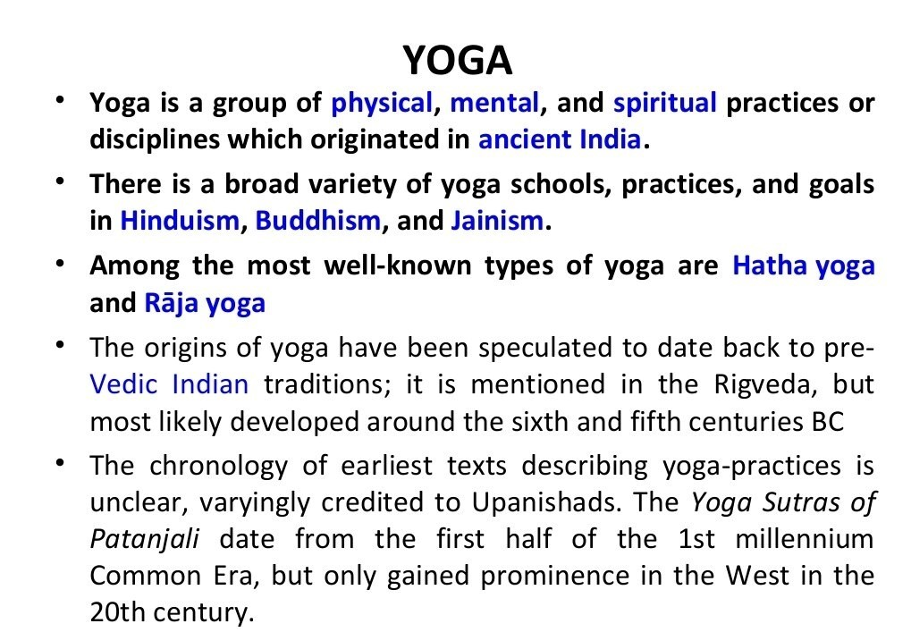

Slide 3
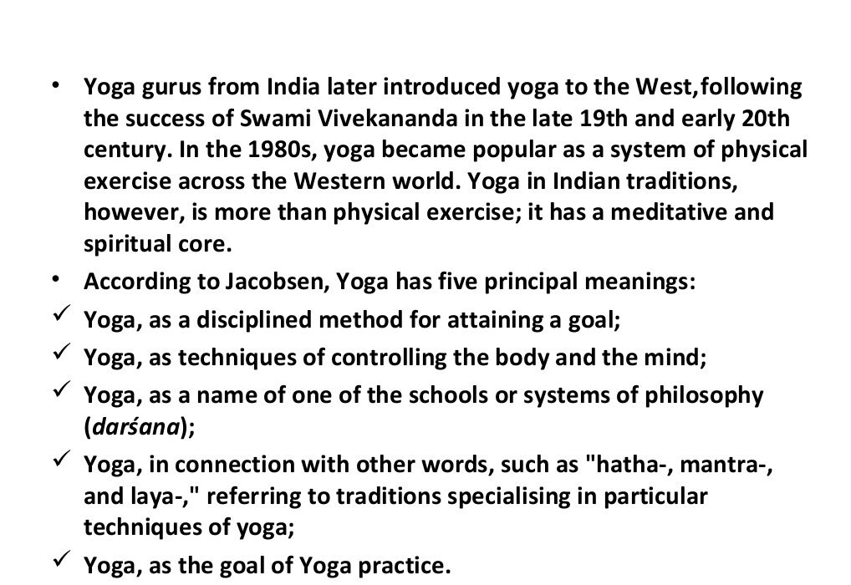

Slide 5
